Slide 1
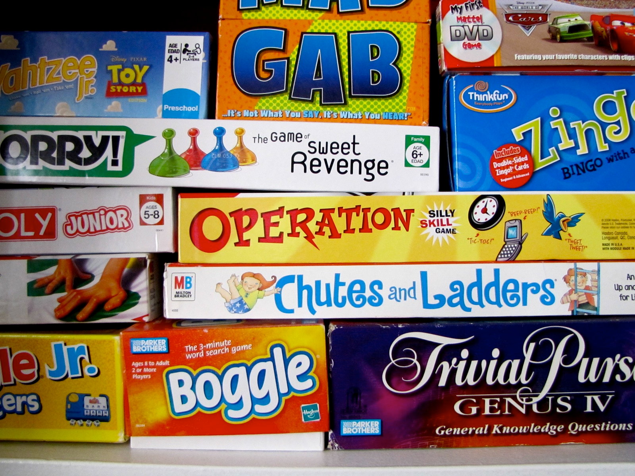
Notes:
How many of you like to play games? Board games, video games, anything that passes the time? Me to.
(CLICK)

Slide 2
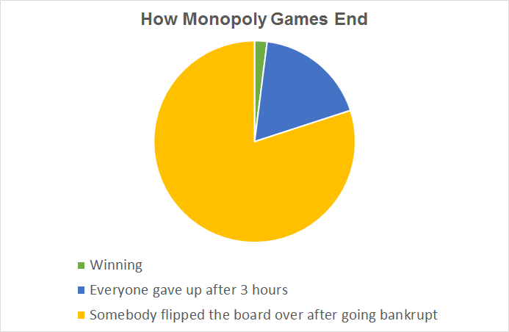
Notes:
I’m sure all of you have heard of Monopoly, the game the forges and strengthens friendships and family ties.
But how did Monopoly come to be? What was the beginning of board games, how have they changed over time, and what connections, if any, can be made between the evolution of tabletop gaming and biological evolution?
(CLICK)

Slide 3
The Evolution of Board Games
History
Transmission/Change over time
Ties to biological evolution
Notes:
Before we can make any connections between the evolution of board games and biological evolution, we must first look at the origins of gaming. After understanding where board games come from in human history, we need to understand how they have been transmitted across human culture, and how they have mutated during that transmission. After understanding this, we can then go on to see what ties, if any, can be made between biological evolution and the evolution of board games.
(CLICK)

Slide 4
The Evolution of Board Games
History
Transmission/Change over time
Ties to biological evolution
Notes:
So first, let’s look at the origin and history of board games.
(CLICK)

Slide 5
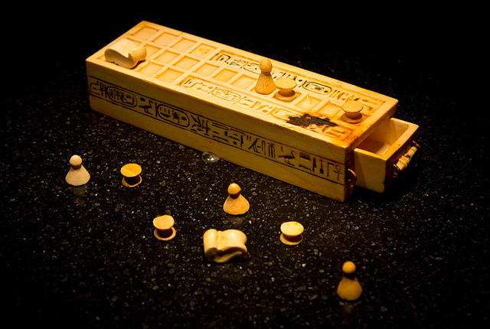
Senet
https://upload.wikimedia.org/wikipedia/commons/thumb/d/d7/Senet_game_pieces_%28Tutankhamun%29.jpg/260px-Senet_game_pieces_%28Tutankhamun%29.jpg
Notes:
Senet is considered to be the earliest known board game in human history. The first Senet board, which dates back to roughly 3100 BC, was found in an ancient Egyptian tomb. The game consists of a simple board with 3 rows of 10 squares, and yet despite its simplistic appearance, scholars and archeaologists are still baffled as to how the game was actually played.
(CLICK)

Slide 6
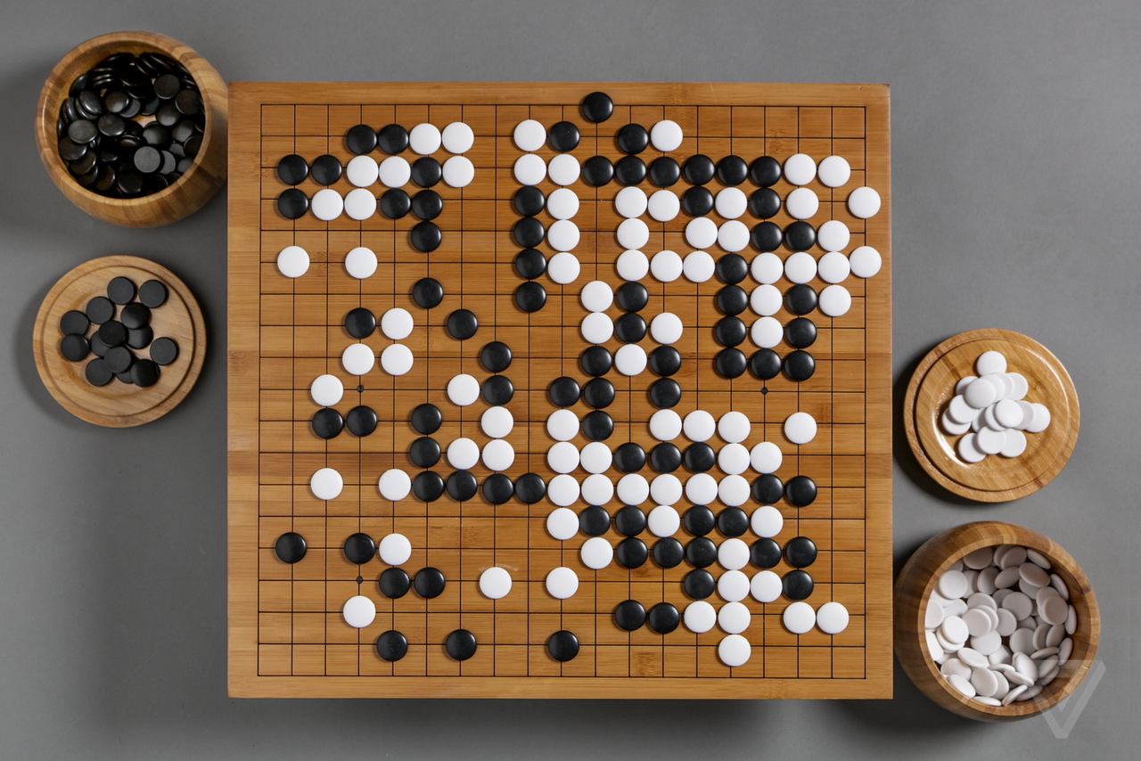
Go
http://paulomenin.github.io/go-presentation/images/goban.png
Notes:
Another board game that set the stage for many other games to come is Go. Go originated in ancient China, around 2,500 years ago. It features a board with 10 vertices emanating out in every direction from the center, and is played with two opponents. Go is considered to be the oldest board game that is still largely played today.
(CLICK)

Slide 7
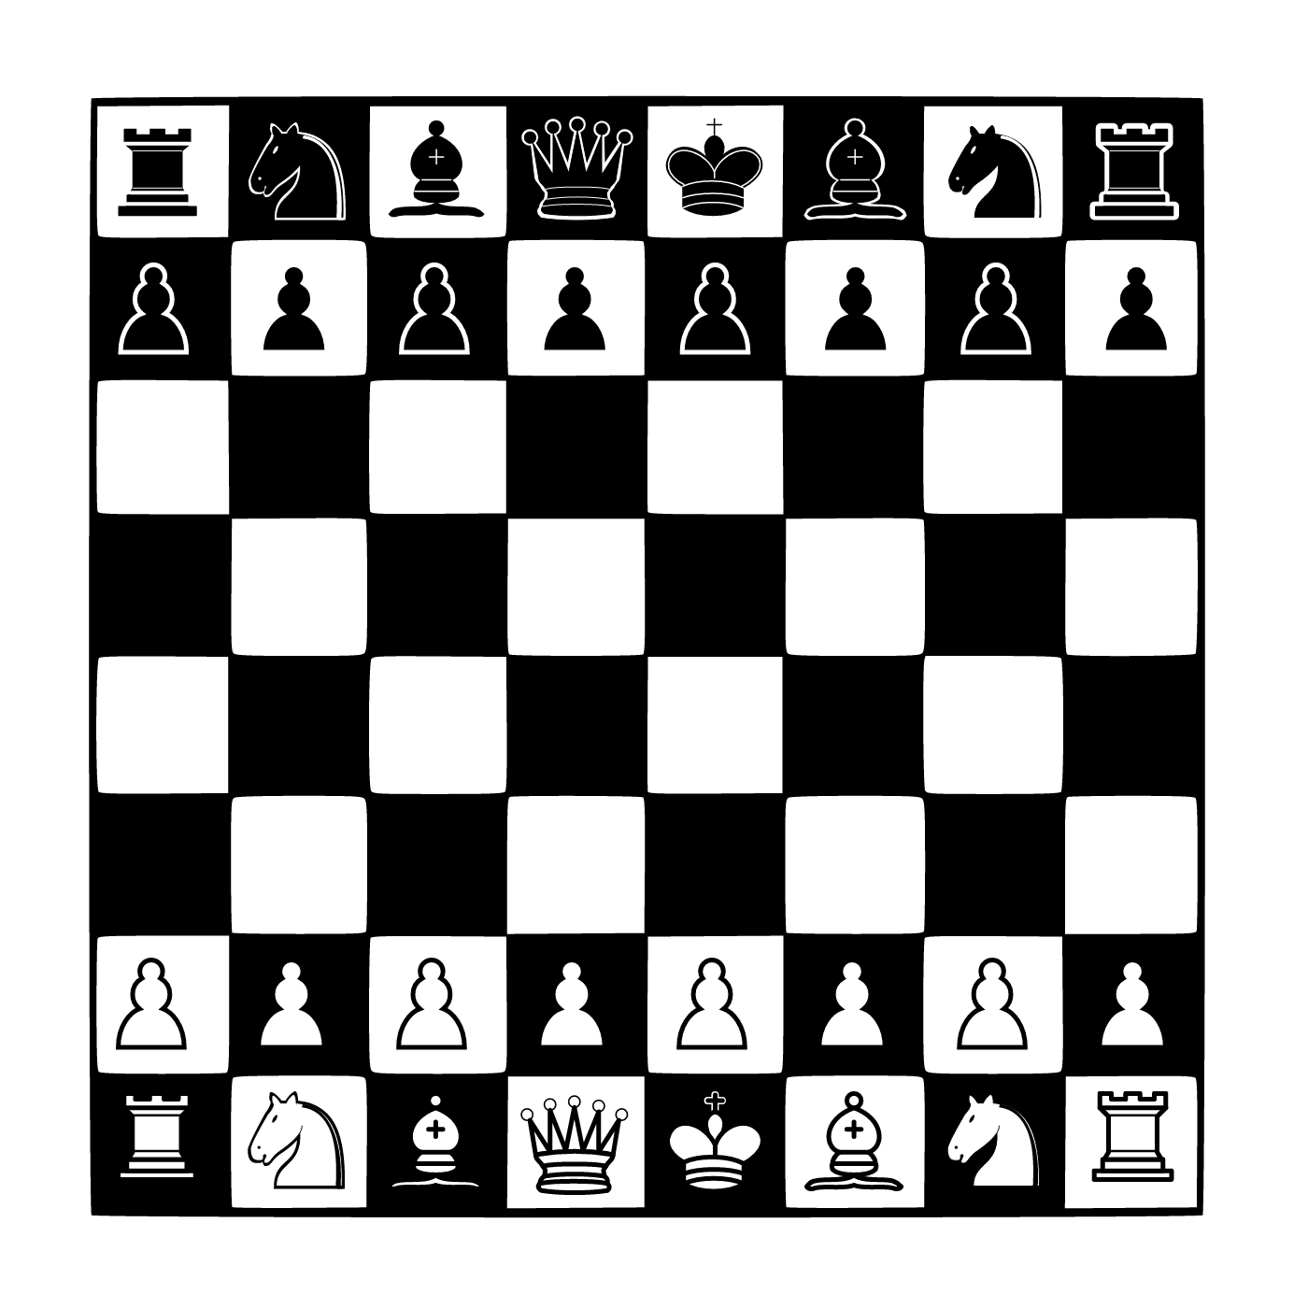
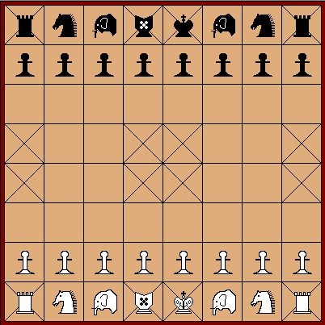
http://learningchess.net/blog/wp-content/uploads/2014/03/chatrang-chaturanga.jpg
https://upload.wikimedia.org/wikipedia/commons/2/2b/AAA_SVG_Chessboard_and_chess_pieces_03.svg
Chaturanga
Chess
Notes:
Chaturanga is an ancient Indian board game that came about around the 6th century AD. This board may look familiar to you because Chaturanga is widely considered to be the ancestor of what is now modern day chess. Fast forward through history and we see board games retain the simple idea of strategy over one’s opponent, with minor cosmetic and rule tweaks.
(CLICK)

Slide 8
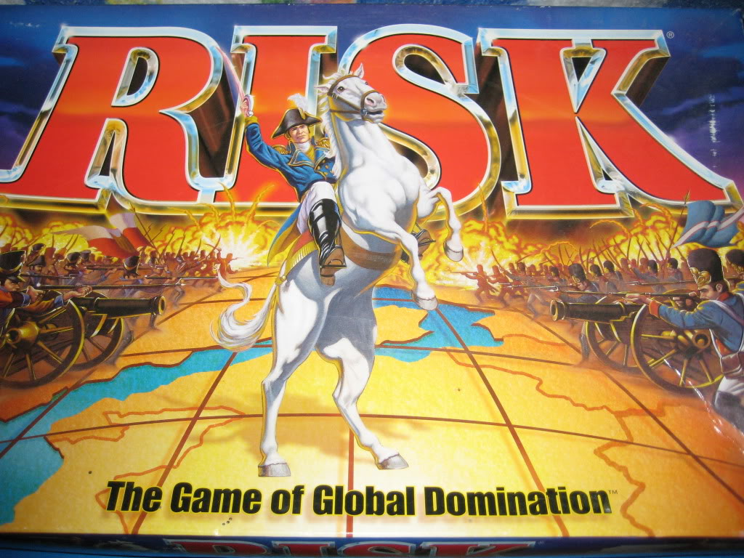
https://play-risk-online.net/wp-content/uploads/2016/04/risk1.jpg
Notes:
Whether it be through maneuvering little plastic armies across the world
(CLICK)

Slide 9

http://www.tkcs-collins.com/truman/monopoly/monop.gif
Notes:
Or buying up every single property on a side of the board.

Slide 10
The Evolution of Board Games
History
Transmission/Change over time
Ties to biological evolution
Notes:
Now that we have discussed the origin and history of board games, let’s move on to…. (CLICK)

Slide 11
The Evolution of Board Games
History
Transmission/Change over time
Ties to biological evolution
Notes:
How board games were transmitted throughout human culture and how games evolved through this transmission.

Slide 12

https://cdn.slidemodel.com/wp-content/uploads/2074-01-worldmap-connections-16x9-1.jpg
Notes:
As the world became more interconnected through trade, political ties, and travel, so to did the world of gaming. Settlers of new lands brought with them their cultural pastimes, and intermingled with other neighboring cultures, thus spawning new breeds of board games that had mutated into a crossbreed of various games throughout history.

Slide 13
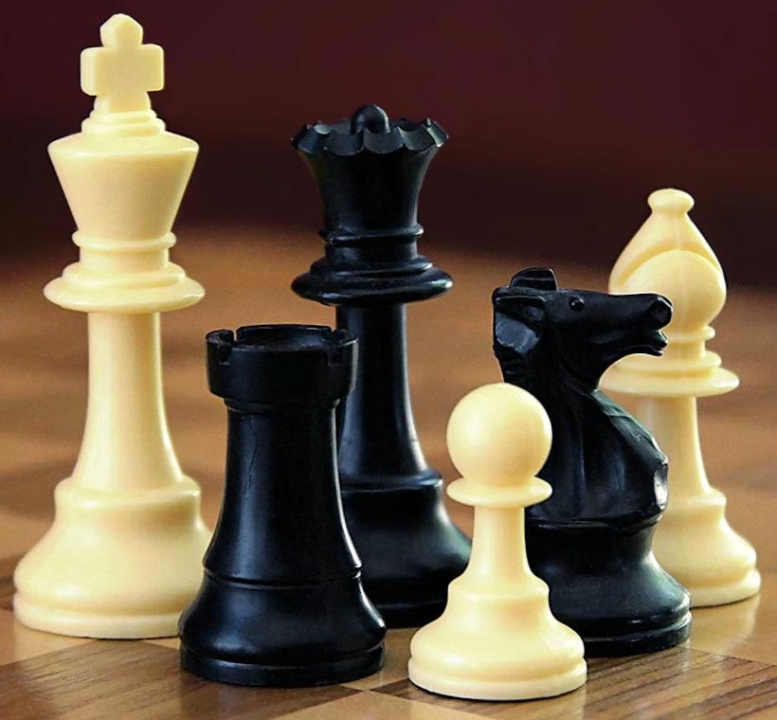
https://upload.wikimedia.org/wikipedia/commons/6/6f/ChessSet.jpg
Notes:
Take Chess for example. Chess

Slide 14
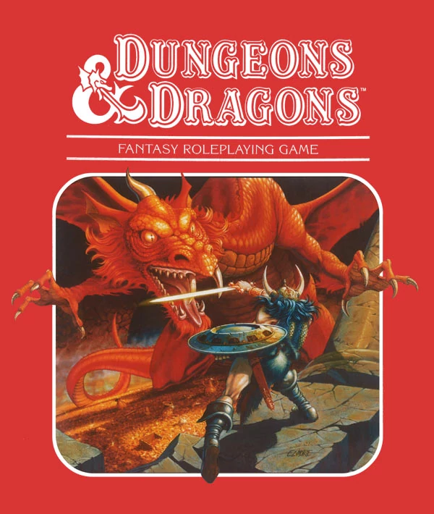
https://vignette3.wikia.nocookie.net/vsbattles/images/a/ac/E6e7_dungeons_dragons.jpg/revision/latest?cb=20170211221920

Slide 15

https://cdn.bleedingcool.net/wp-content/uploads/2014/08/gen-con-logo.jpg

Slide 16
The Evolution of Board Games
History
Transmission/Change over time
Ties to biological evolution
Notes:
How board games were transmitted throughout human culture and how games evolved through this transmission.

Slide 17
The Evolution of Board Games
History
Transmission/Change over time
Ties to biological evolution
Notes:
How board games were transmitted throughout human culture and how games evolved through this transmission.

Slide 18
Biological vs. Board Game Evolution
Change over time due to a selective system
Inheritance of information through generations
Variation/Mutation through reproduction

Slide 19
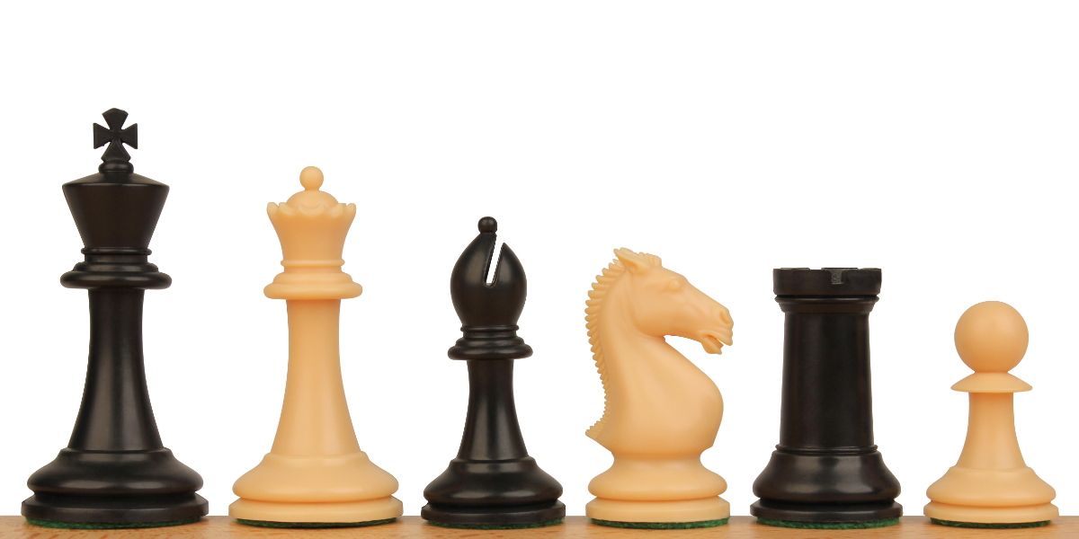
Symbolic Inheritance in Board Games
https://cdn6.bigcommerce.com/s-5p6k1/products/2298/images/8646/plastic-chess-pieces-protourney-black-camel-both-1200x600__65584.1445964290.1280.1280.jpg?c=2

Slide 20
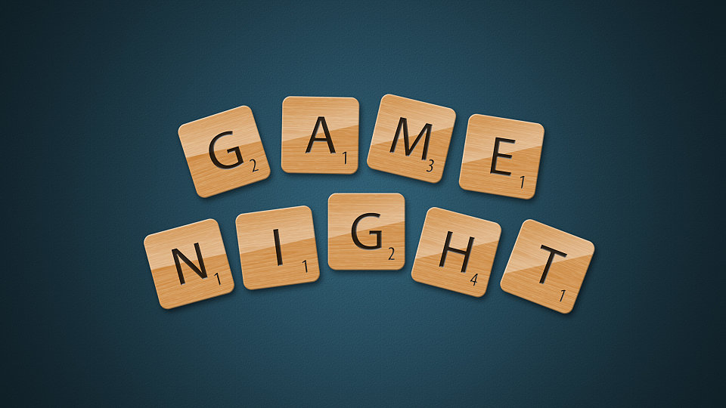
Notes:
So with all of this knowledge in mind, go out and have yourself a game night.

